Slide 1
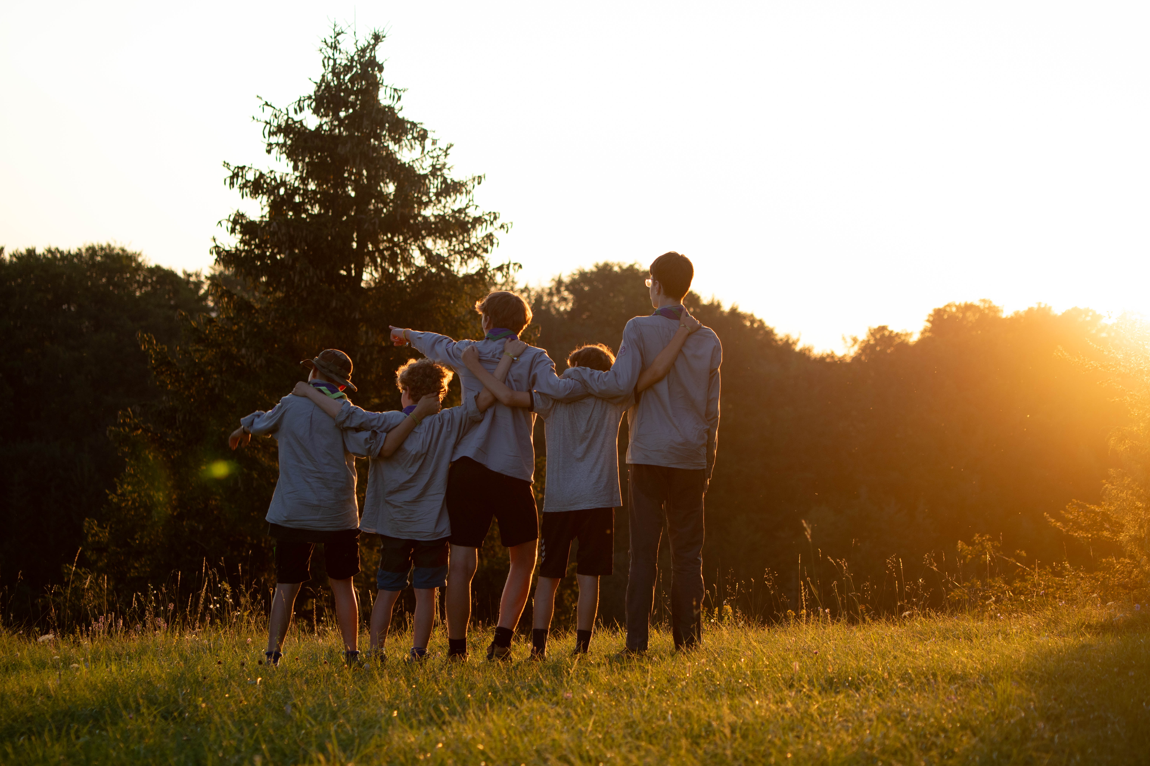
IST Contingent
National Jamboree 2026
04.01.2026
VCPwttbg/ Nico Seeber
Notes:
Noah

Slide 2
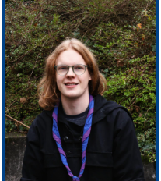
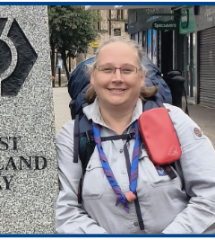
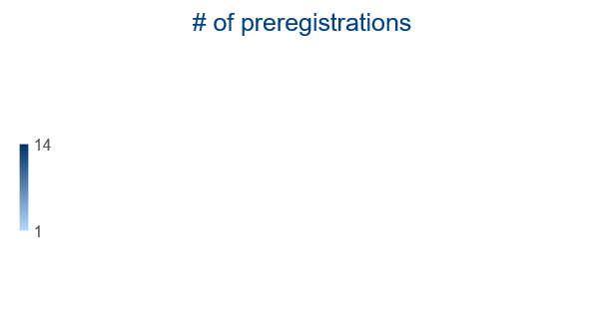
IST Contingent
Noah Kriesch
25 years old
Living in Heidelberg
Master’s student in Physics
The national Jamboree next year will be my fourth one
marimKA (Annika Habekost)
51 years old
Living in Hamburg
R&D Specialist Aerosol shelf life
The national Jamboree next year will be my third one
Quelle: VCP / Noah Kriesch Quelle: VCP / Annika Habekost
Status Pre-registration:
55 Scouts / Guides
22 different countries
aged between 18 and 65
Notes:
Noah

Slide 3
Timeline up to the camp
28.07.2026 Arrival IST at campsite
Mandatory attendance of a course „Safe from harm“
09.08.2026 Departure IST
08.08.26 Staff party night
30.07.-08.08.26 National Jamboree
Application open 06.01.-16.03.2026
– payment of camp fee within 3 weeks after confirmation
April/May – fill-out medical questionnaire
requires
endorsement letter!

Slide 4
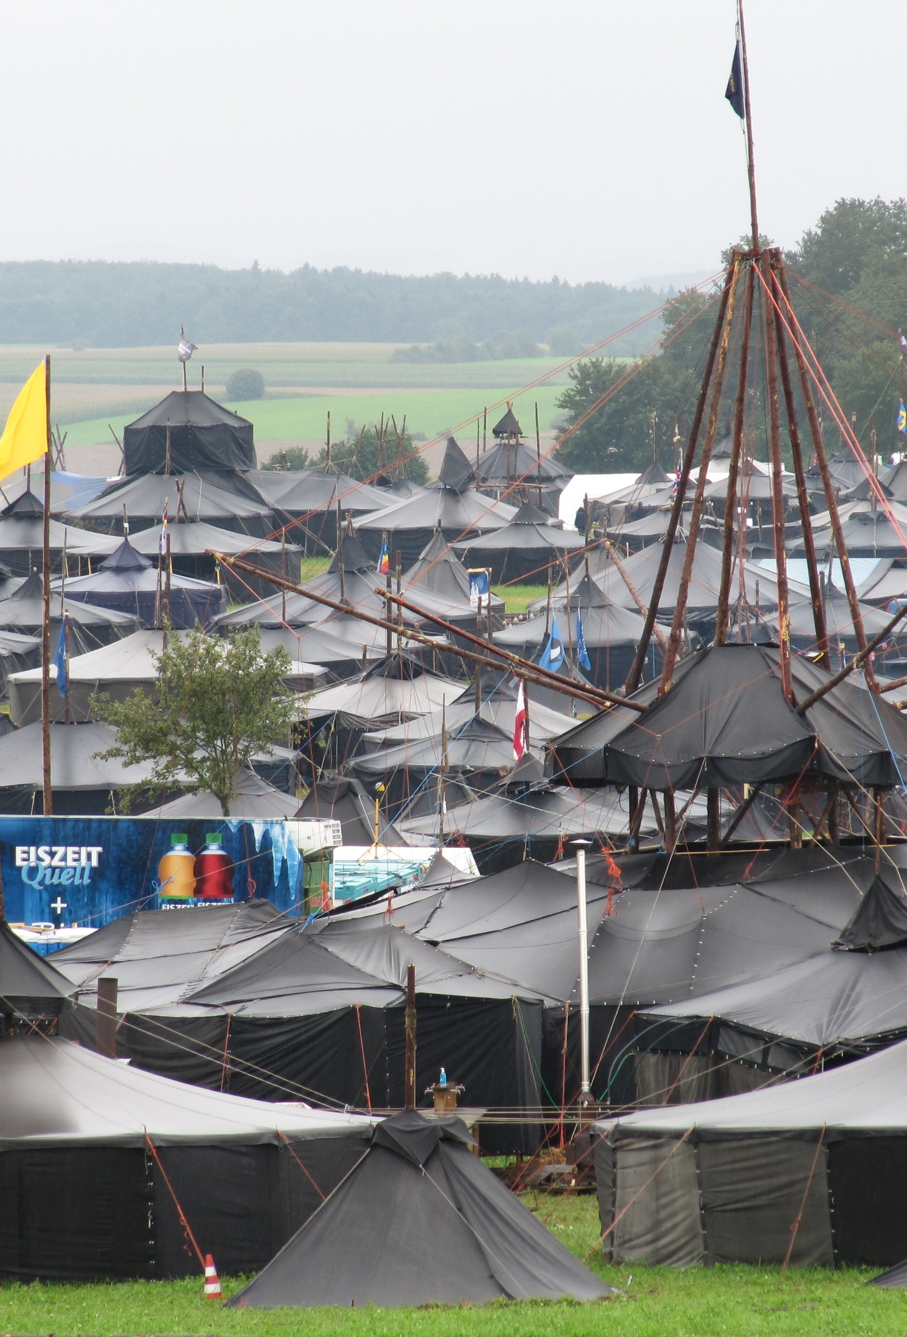
Fact about our national Jamboree 2026
Date: 28.07.2026 bis 09.08.2026 (for IST)
Location: Jugendzeltplatz Almke (DE-38446 Wolfsburg)
Theme: „Ungeschrieben – Geschichte wird, was du draus machst“ “unwritten - stories are still waiting to be imagined and written”
More than 4000 Scouts
Hundreds of black tents – varying in size and shape
Sanitary facilities will mainly compose of portable toilets, sinks with running water and shower tents
Camp will be divided in Subcamps – IST will be located at Subcamp for central staff
Cooking in groups – IST contingent will be one group
Black tents as sleeping options for all IST – mixed, gender separated and FLINTA
There will be central program, also opportunities for individual program
Quelle: VCP / Annika Habekost

Slide 5
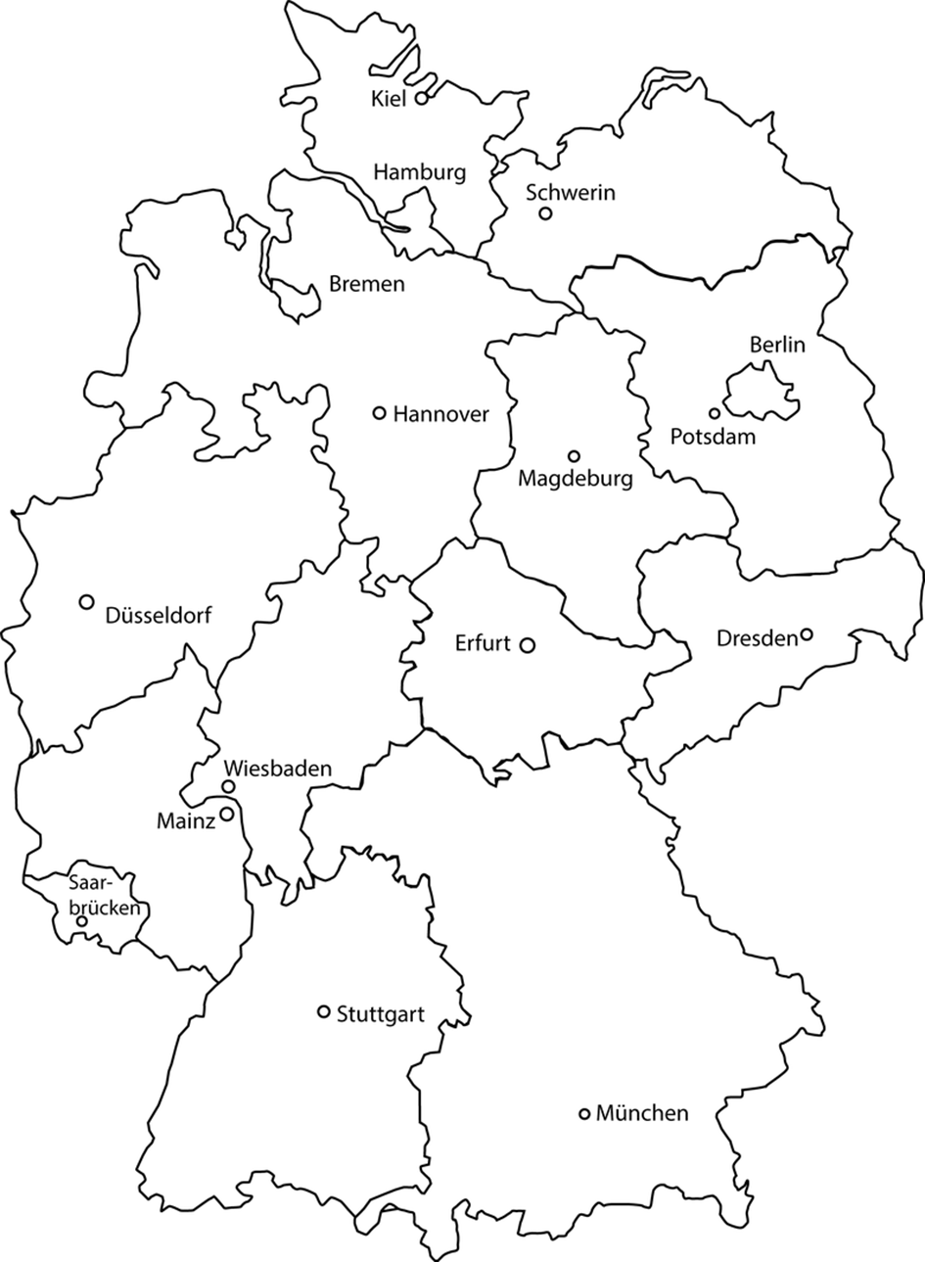
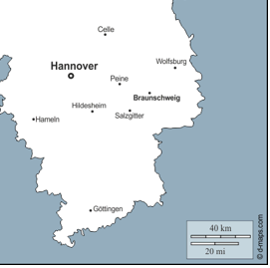
Arrival & Departure to the campsite
For international flights, the closest airports are Braunschweig-Wolfsburg, Hamburg, Hannover and Berlin.
The nearest train station is Wolfsburg main station.
Frankfurt Airport has good train connection via ICE to Wolfsburg main station
A shuttle from the main station Wolfsburg to the campground will be provided but needs to be requested in advance.
Parking space for private cars is limited
If support is needed for planning your trip, please let us know.
Jugendzeltplatz Almke

Slide 6
IST during camp
It is the first time we have an official IST contingent at our National Jamboree, therefor we are still working on plans and implementation of the IST-group into the camp structure.
Our idea / intention:
Forming a group – this is why we want you to join already 2 days before camp starts:
get to know each other
get familiar with the camp structure
setup our camp-ground before supporting other sections
Showing you our way of scouting and being interested in get in touch with your traditions and way of scouting
Planning a day trip out of the camp to show you a bit of our beautiful country, maybe not complete covered by the camp fee
Your role / tasks:
Supporting the program section:
workshop leader
staff at the camp big field game
Creating /building decorative elements to serve the camp theme
Camp safety – supporting shifts of the camp guard
Supporting the service/info desk
Supporting the various cafes at the camp as service staff
…..

Slide 7
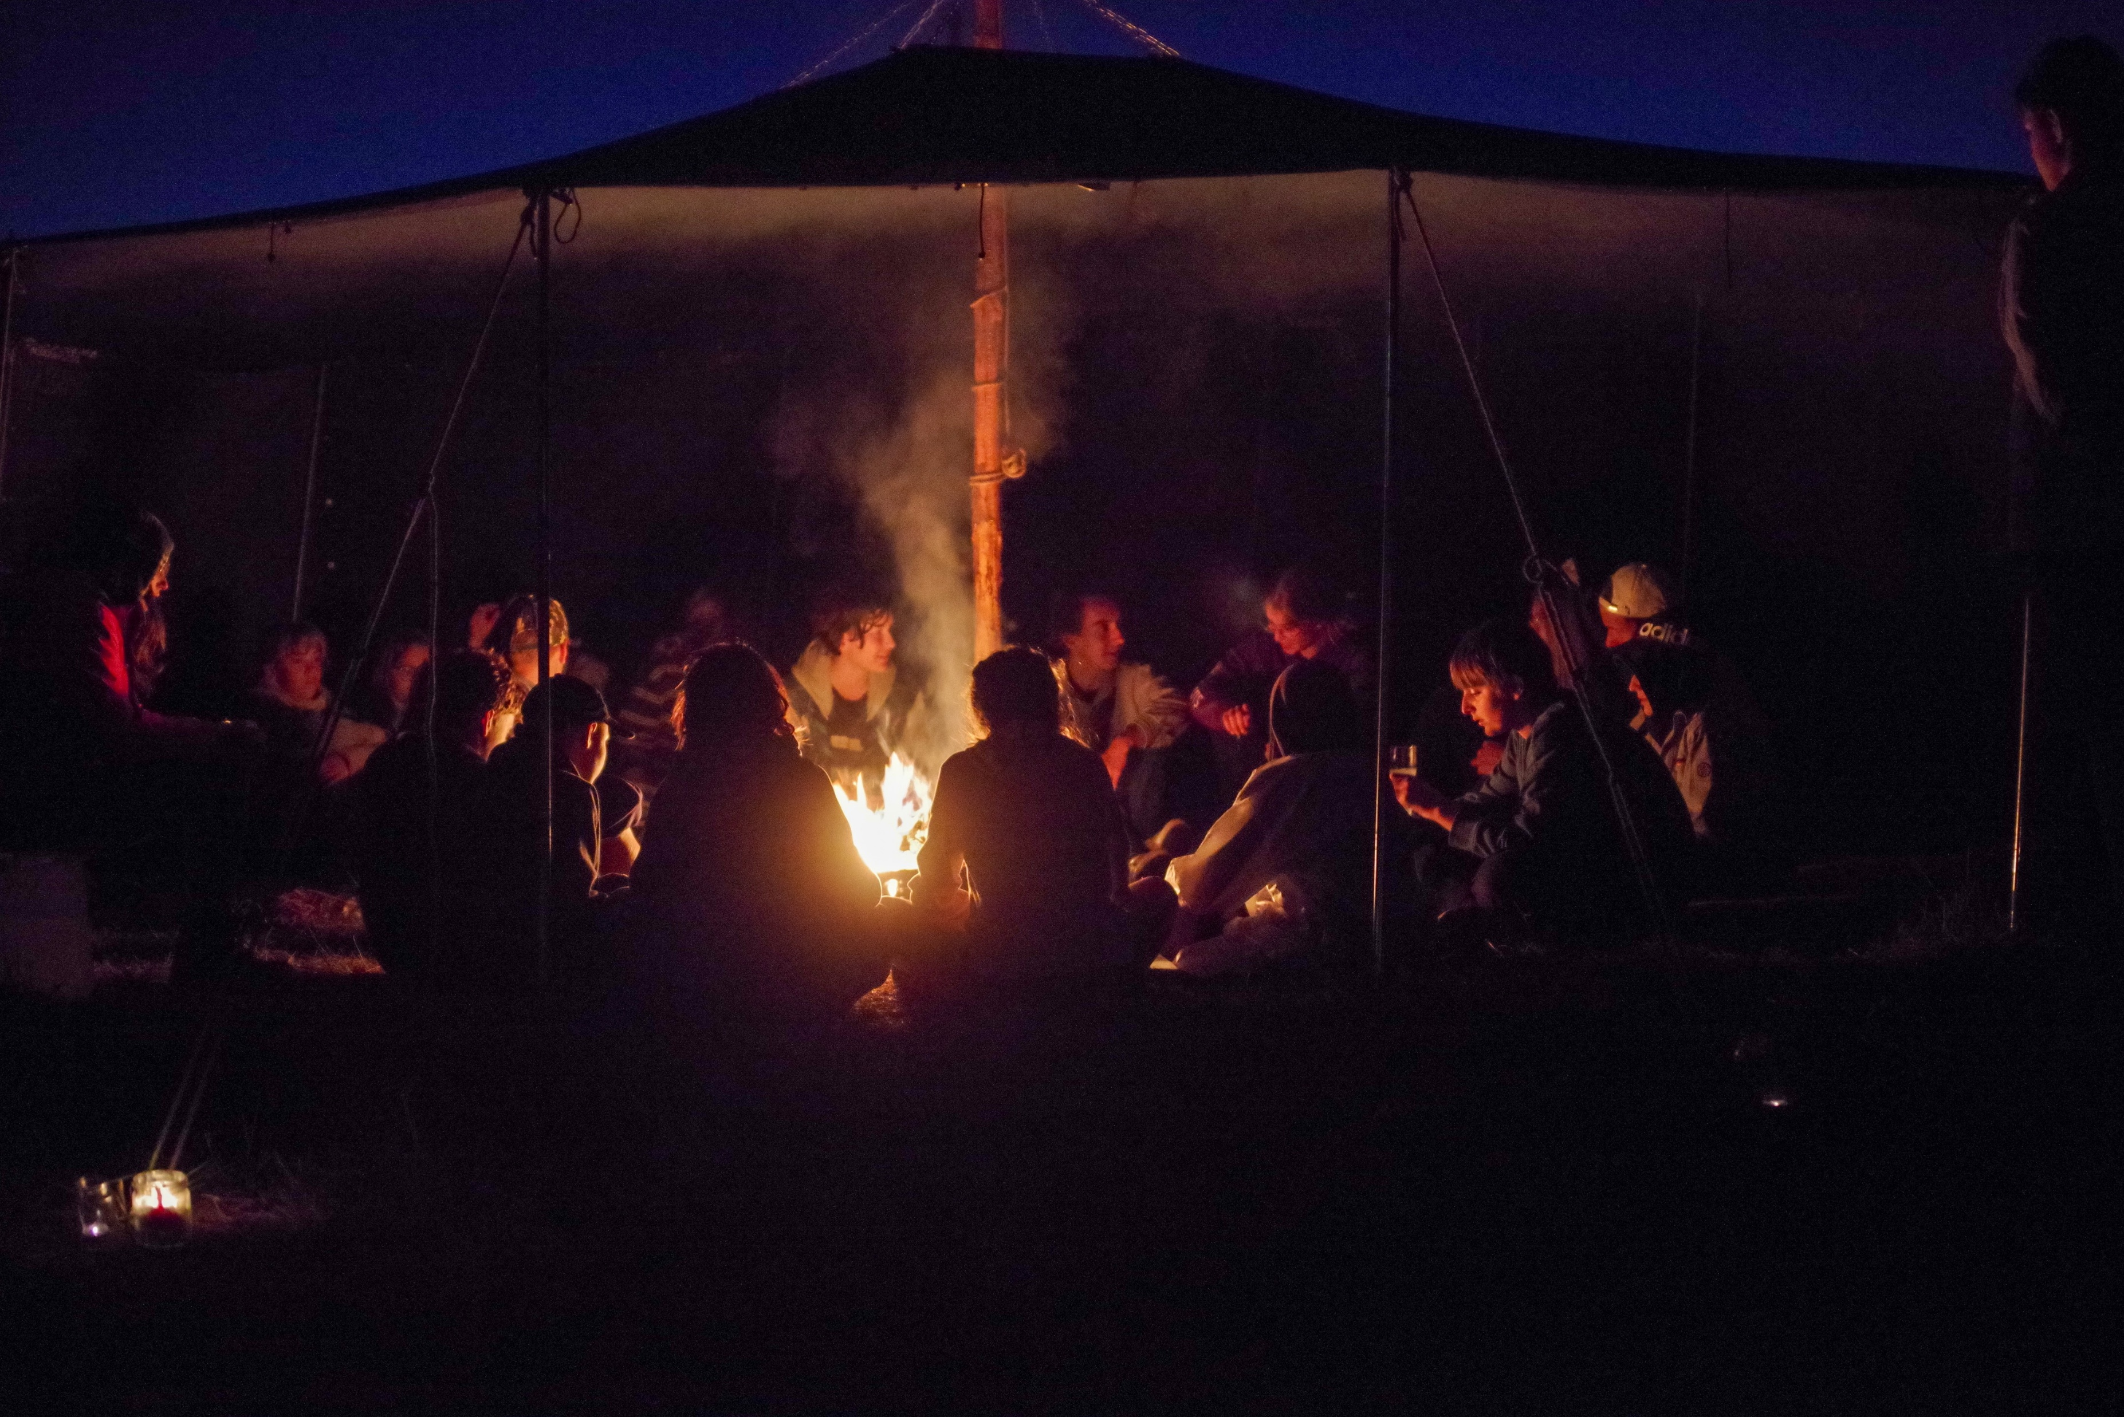
Material / Packing List
To enjoy our camp, we recommend:
Sleeping bag
Sleeping mat
Personal tableware (beaker/dish/cutlery/tea towel)
Small pocket torch
Rain jacket
Sturdy shoes
Sun protection
€ - cash (payment in all cafe`s on the camp)
Songbooks / music instrument (as desired)
and of course, your personal stuff
Our contribution of material :
Providing black tents for sleeping – mixed, gender separated and FLINTA
Build up (with your help ☺) Jurten for daily / evening stay to be protected against sun or rain
Quelle: VCP / Benedikt Bahl
If you need any supply of single items, please let us know (preferably by the end of March)

Slide 8
Costs / Funding opportunities
The fixed camp fee is 349 €.
Included is:
Accommodation
Food
Program at the camp
Camp badge
Not included is:
Travel cost to and from the camp
Visa cost
Camp merchandise
Snacks/drinks in the cafes at the camp
Remark: You are responsible to hold an appropriate health insurance covering your complete stay
Funding opportunities are limited:
Not applicable for single persons, only possible for groups
Age limit is 27
Application for the possible funding opportunity is linked to a German partner group; in case of IST, our idea is to create a partner group of national staff members to meet the requirements
At this stage of planning we cannot guarantee any fundings

Slide 9
Any questions?
Thank you for your attention!

